Slide 1
Battle of Neighbourhoods - Delhi
Capstone Project for Coursera

Slide 2
Introduction
In this project we will be analyzing the neighbourhoods on the basis of the metro trains stations located in the city of Delhi.
There are 137 stations in the metro transit in the city of Delhi which is the most densly populated place in India. In this project the stations will be used to understand the city and its neighbourhoods.
Later on in the project K Means is used to cluster the data.

Slide 3
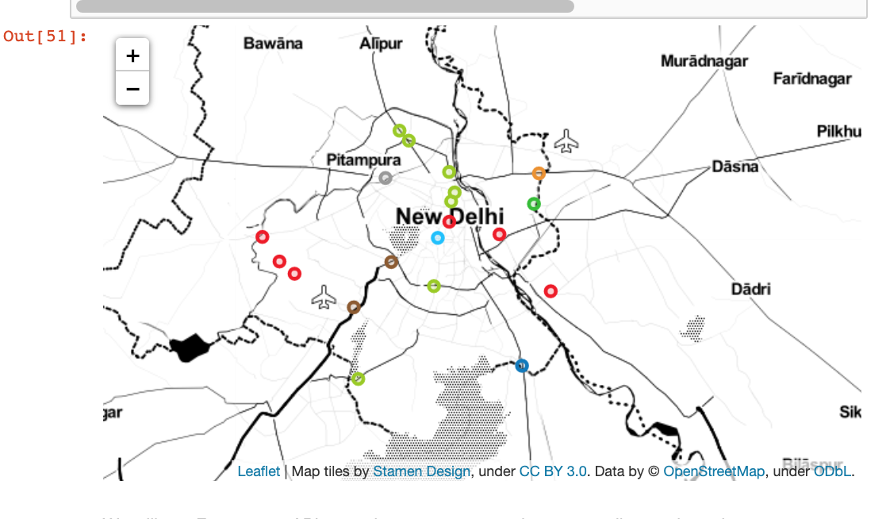
Map of the Stations

Slide 4
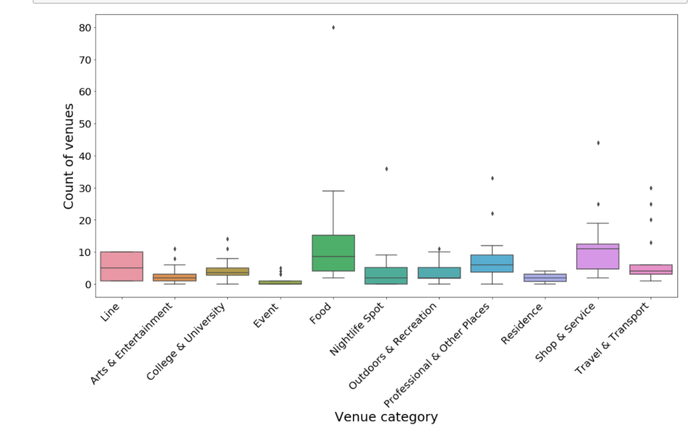
Box Plot to Understand the Results

Slide 5
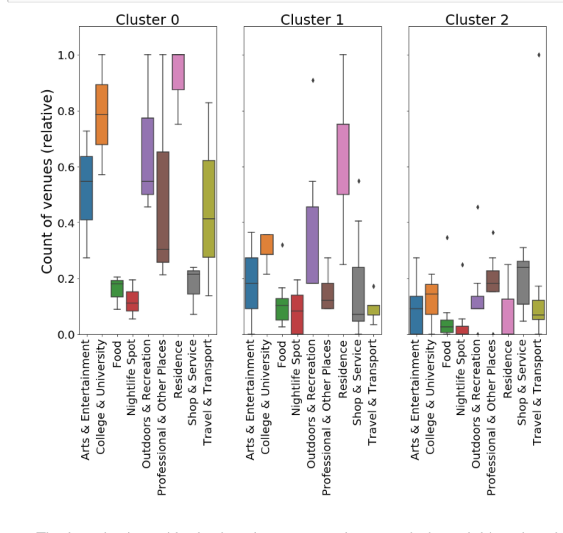
After Clustering Box Plots

Slide 6
Results
1) Cluster 0 has an overall high scores for all venue categories. This is the most diversely developed part of the city. (Represented in Blue Blobs)
2) Cluster 1 has highest marks for Residence Places and next highest score was outdoor and recreation. This must be a residential area.(Represented in Green Blobs)
3) Cluster 2 has an overall low marks. Best scores are observed in shop & service.(Represented in Orange Blobs)

